Slide 1
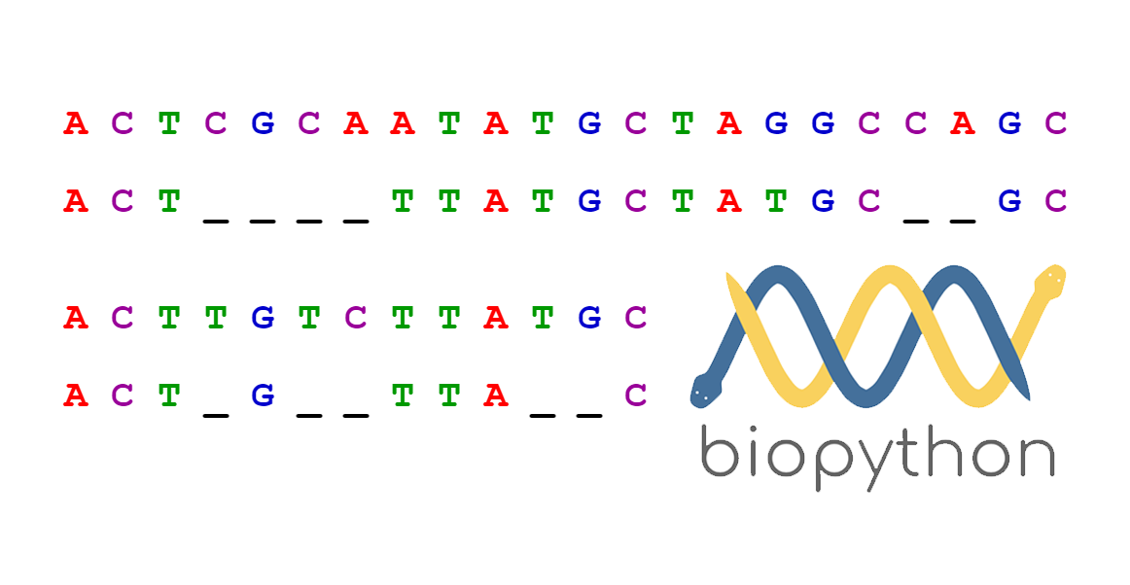
Sequence Alignment
Lecture – 5
Department of CSE, DIU

Slide 2
CONTENTS
Sequence Alignment
- Why align sequences
2. Sequence Alignment Methods - Pairwise Alignment - Multiple Sequence Alignment
3. Pairwise Sequence Alignment Methods -Global Alignment (Needleman-Wunsch) - Local Alignment (Smith-Waterman)

Slide 3
1. Sequence Alignment
Why and how align sequences

Slide 4
Sequence Alignment
A way of arranging the sequences of DNA, RNA, or protein to identify regions of similarity that may be a consequence of functional, structural, or evolutionary relationships between the sequences
CTGTCG-CTGCACG
-TGC-CG-TG----

Slide 5
Why align sequences?
Useful for discovering
Functional
Structural and
Evolutionary relationship
For example
To find whether two (or more) genes or proteins are evolutionarily related to each other
Two proteins with similar sequences will probably be structurally or functionally similar

Slide 6
2. Sequence Alignment Methods
Pairwise and Multiple

Slide 7
Pairwise Sequence Alignment
A pair of sequences as input
Align them in such a way that, for that particular alignment the assumed region of similarity produces higher score than all the other alignments
Methods
- Global Alignment (Needleman-Wunsch) - Local Alignment (Smith-Waterman)
CTGTCGCTGCACG--
-------TGC-CGTG

Slide 8
Pairwise Sequence Alignment
Idea:
Display one sequence above another with spaces inserted in both to reveal similarity
A: | C | A | T | - | T | C | A | - | C
 | | |  | | |  |  | | | | |  | |
B: | C | - | T | C | G | C | A | G | C

Slide 9
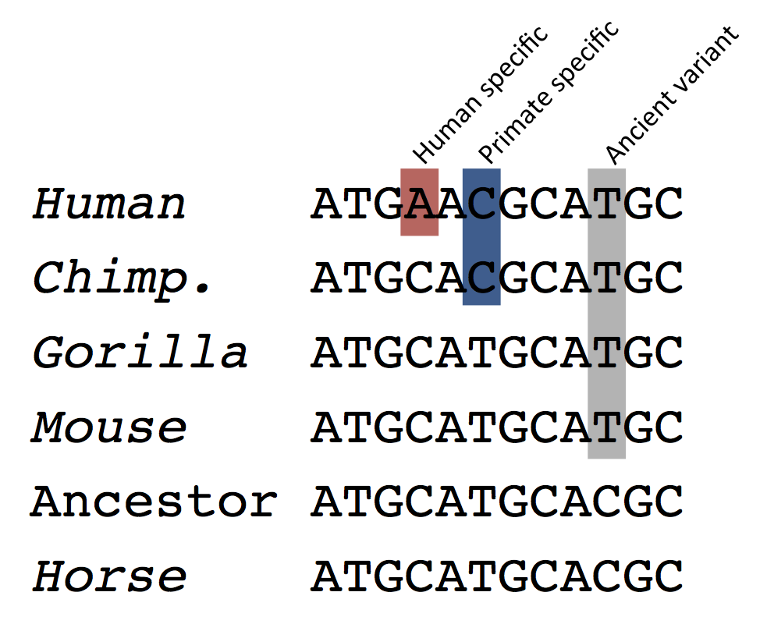
Multiple Sequence Alignment
Three or more than three sequences as input
Align all the sequences altogether in such a manner that the alignment produces highest score

Slide 10
3. Pairwise Sequence Alignment
Global and Local methods

Slide 11
Global Alignment (Needleman-Wunsch)
3 Major Steps
-Create 2D Matrix
-Trace back
-Final Alignment
Trace back
- Start from Cell (Row, Col)
- Go back up to Cell (0,0)
Create 2D Matrix
- Row x Col 2D matrix draw (Row , Col size of seq1 and seq2 respectively)
- Place 2 seqs as Row and Column Header
- Cell (0,0) = 0
- Cell (0,1) to Cell (0,Column) and Cell (1,0) to Cell (Row,0) value = delete gap value from previous cell value
- For other cell values, follow equation in (1)
Final Alignment
- Start from Cell (Row, Col)
- If then, place character in both seq
- If or then character in start seq & gap in end seq

Slide 12
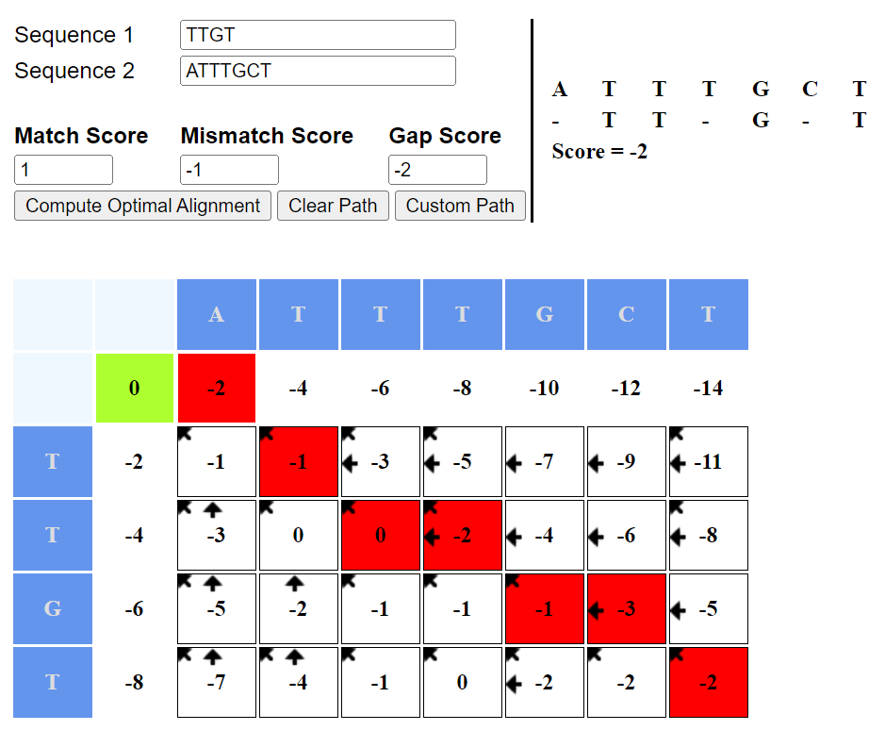
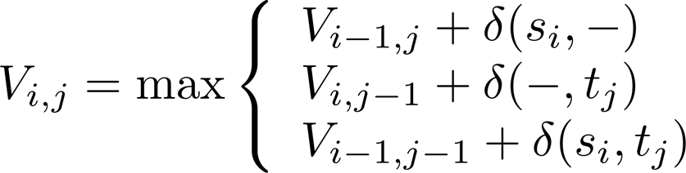
Global Alignment (Needleman-Wunsch) - Example
Input
- seq1 = TTGT
- seq2 = ATTTGCT
Scoring Scheme
δ(x, x) = 1 (Match)
δ(x,-) = -2 (Gap)
δ(x, y) = -1 (Mis match)
Eq. 1: Cell Value

Slide 13
Local Alignment (Smith-Waterman)
3 Major Steps
-Create 2D Matrix
-Trace back
-Final Alignment
Trace back
- Start from each Cell which has the maximum value in the entire matrix
- Go back up to the Cell where first time 0 occurs
Create 2D Matrix
- Row x Col 2D matrix draw (Row , Col size of seq1 and seq2 respectively)
- Place 2 seqs as Row and Column Header
- First Row, First Column all value = 0
- For other cell values, follow equation in (2)
Final Alignment
- Start from each Cell with max value
- If then, place character in both seq
- If or then character in start seq & gap in end seq

Slide 14
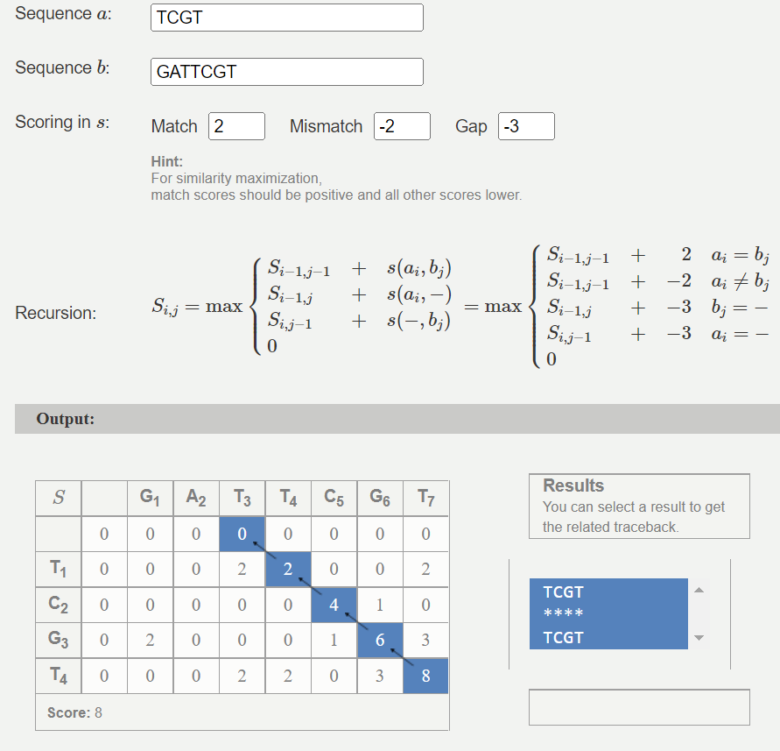
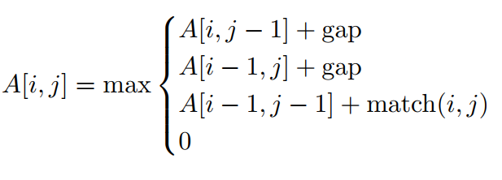
Local Alignment (Smith-Waterman) - Example
Input
- seq1 = TCGT
- seq2 = GATTCGT
Scoring Scheme
δ(x, x) = 2 (Match)
δ(x,-) = -3 (Gap)
δ(x, y) = -2 (Mis match)
Eq. 2: Cell Value

Slide 15
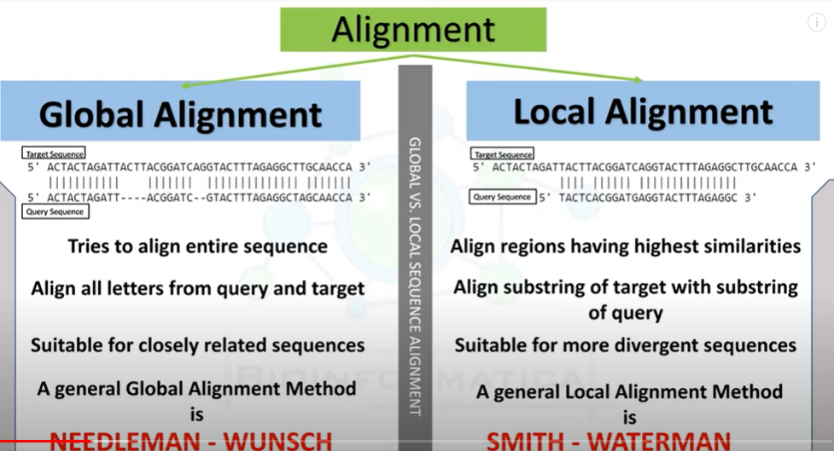

Slide 16
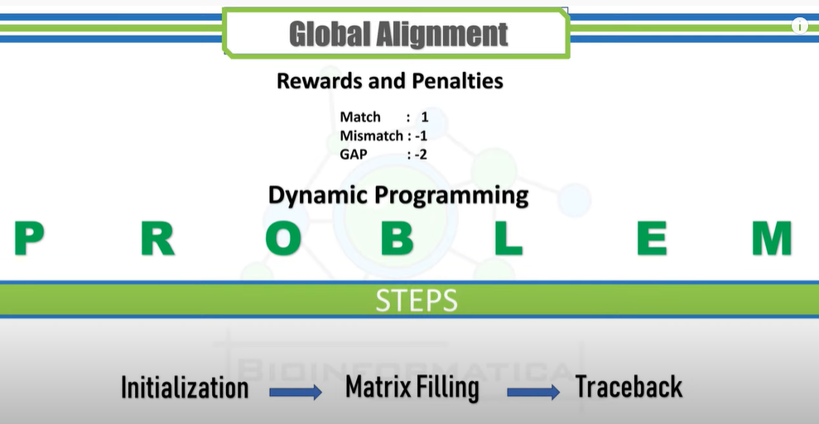
Global Sequence Alignment

Slide 17
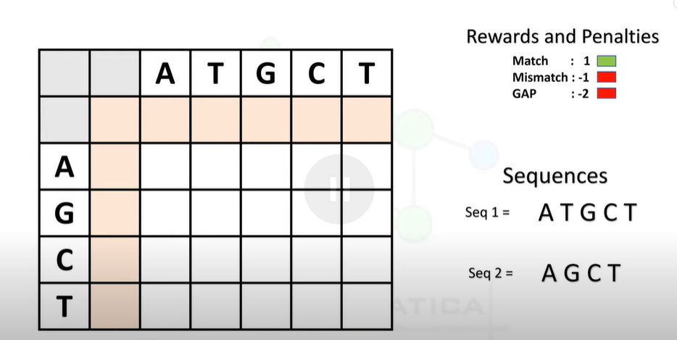

Slide 18
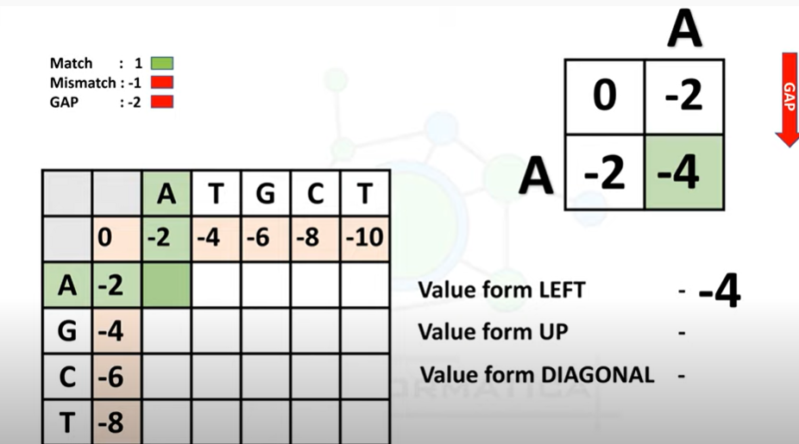

Slide 19
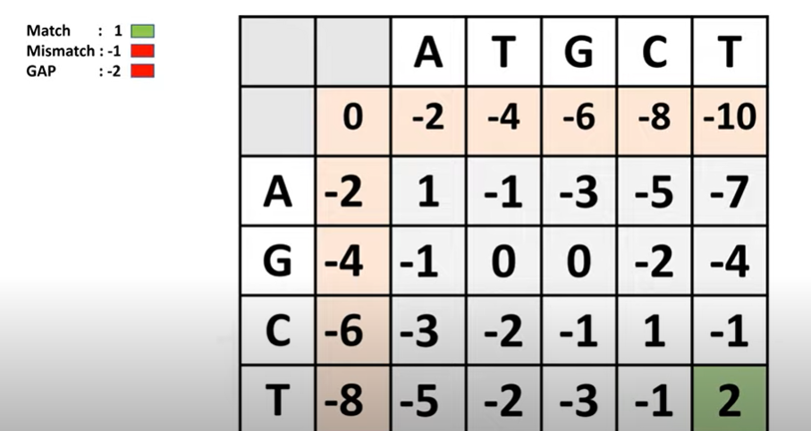

Slide 20
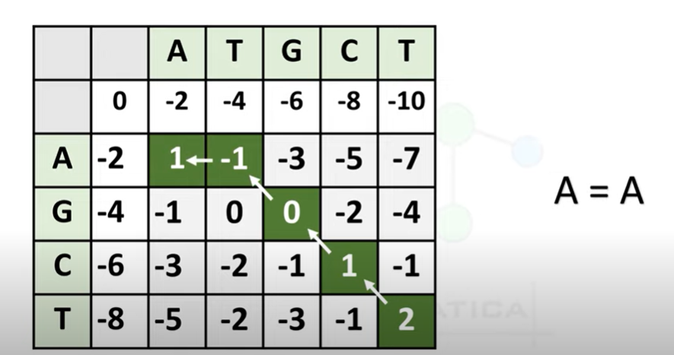

Slide 21
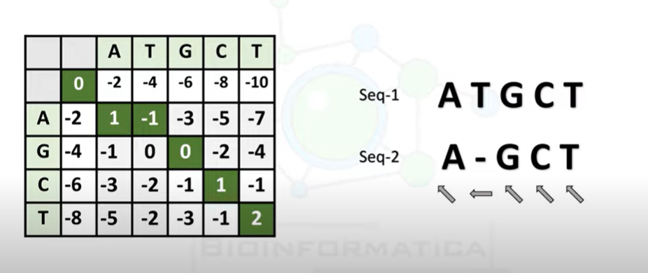

Slide 22
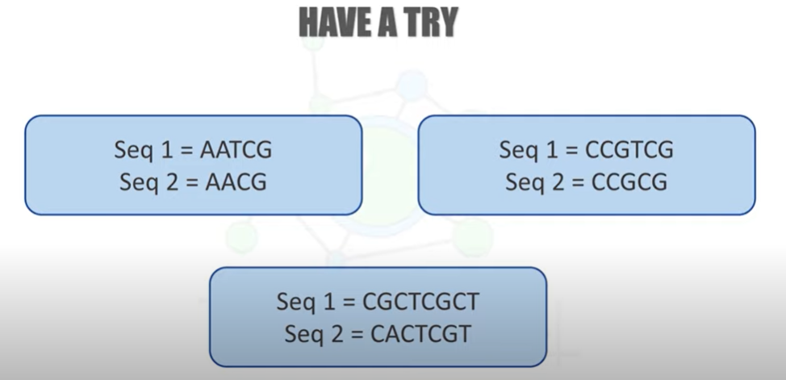

Slide 23
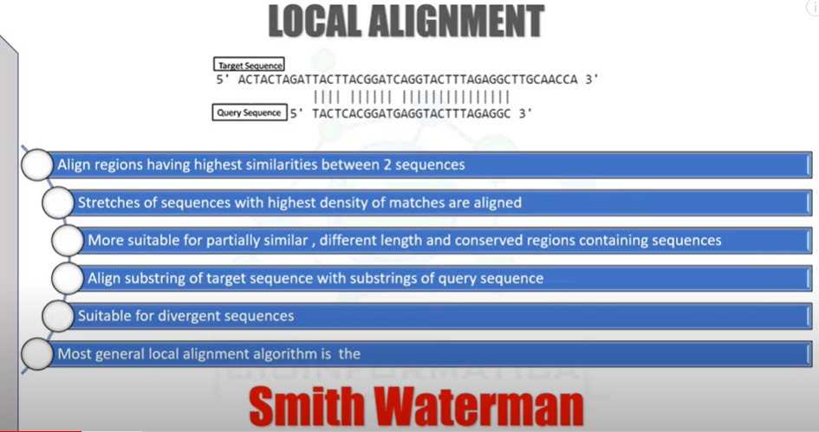

Slide 24
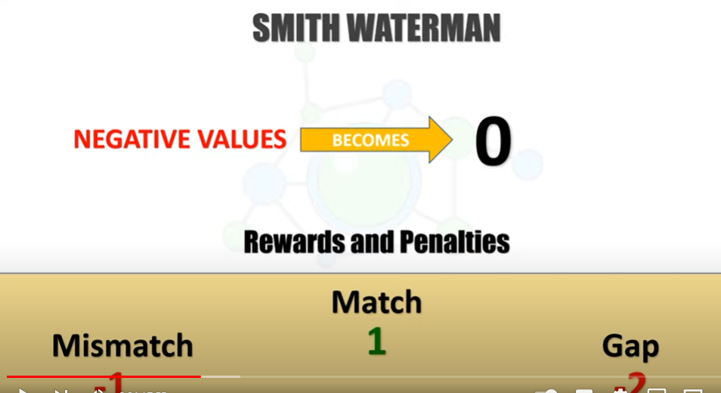
Local Sequence Alignment

Slide 25
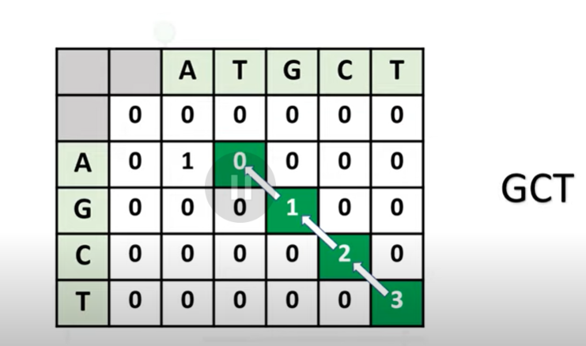

Slide 26
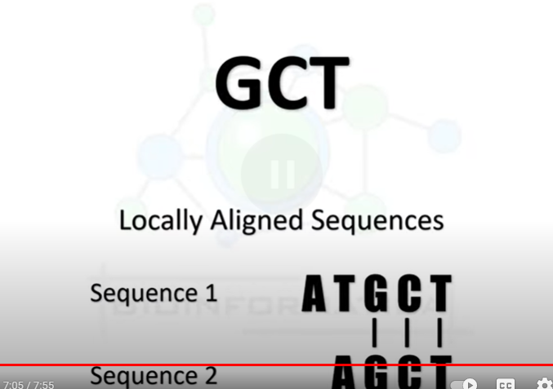

Slide 27
